Slide 1


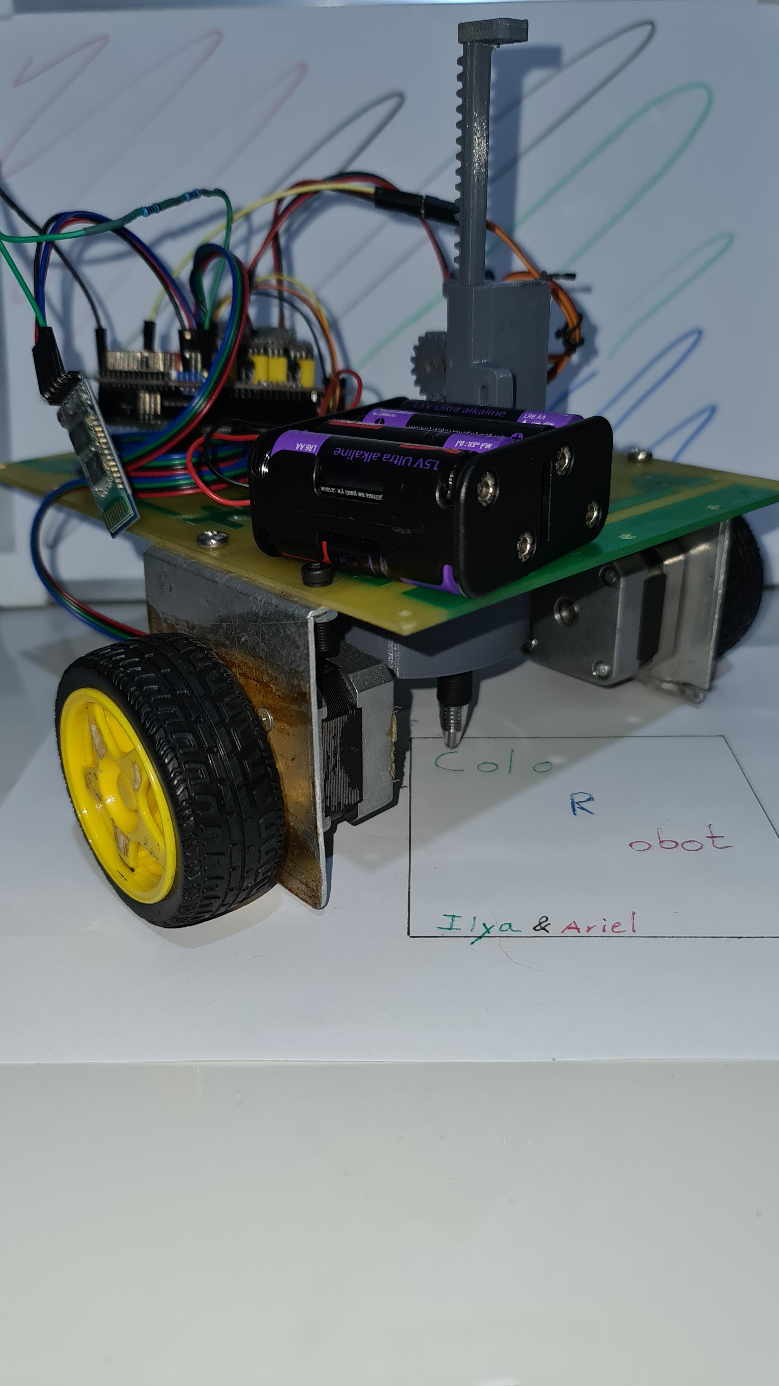
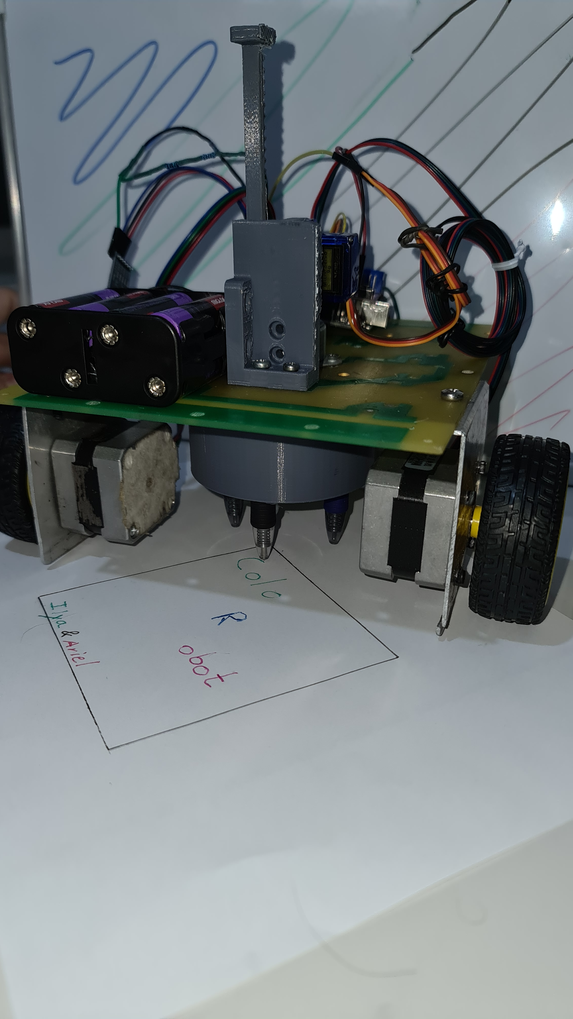


Color Robot
Make your digital drawing come alive…
This unique robot allows you to draw digitally whatever
comes to your mind and see it implemented physically on a paper
or a canvas.
The designated color switching mechanism, differs our project from different plotter by now introducing a splash of color to the drawing.
Student’s names: Ilya Fradlin , Ariel Marber
Instructor’s name: Harel Vaknin
A Project in Internet of Things (IoT)

